Slide 1

Machine Learning Project
Movie Recommendation System
Using Cosine Similarity Algorithm
Team Members:
Tejashri Chavan(RA2111027010110)
Esha Rai(RA2111027010110)

Slide 2

INTRODUCTION
These System use advanced algorithm and data analysis techniques to suggest movies that you might like based on your viewing history or other factors
They make it easier for us to discover new movies that we might not have otherwise found
They also help businesses like streaming services to keep their users engaged and coming back for more

Slide 3
Types of Recommender System
.
.
Content Based Recommender
.
Collaborative Filtering
Hybrid

Slide 4
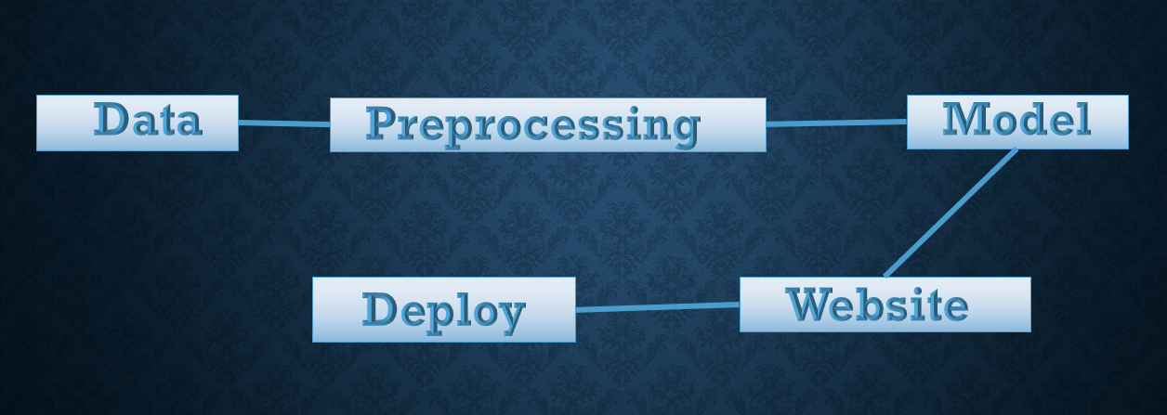
Project Flow

Slide 5
COSINE SIMILARITY ALGORITHM
Cosine similarity is a measure of similarity between two vectors.
It is calculated by taking the dot product of the two vectors and dividing it by the product of their norms.
In the code, the cosine similarity is used to calculate the similarity between the tags of two movies.
The tags are first converted into vectors using a CountVectorizer.
The CountVectorizer counts the number of times each word appears in a document.
The vectors are then compared using the cosine similarity function.
The cosine similarity algorithm is a popular choice for recommender systems because it is relatively easy to implement and it is effective at measuring the similarity between two vectors.

Slide 6
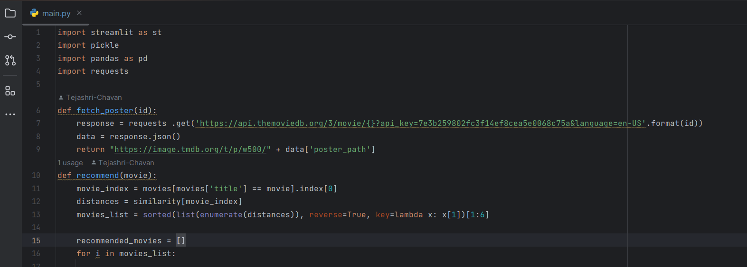
CODE

Slide 7
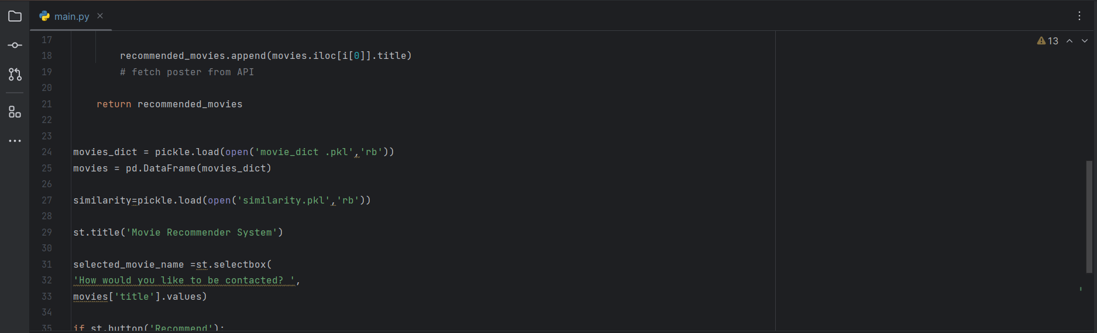

Slide 8
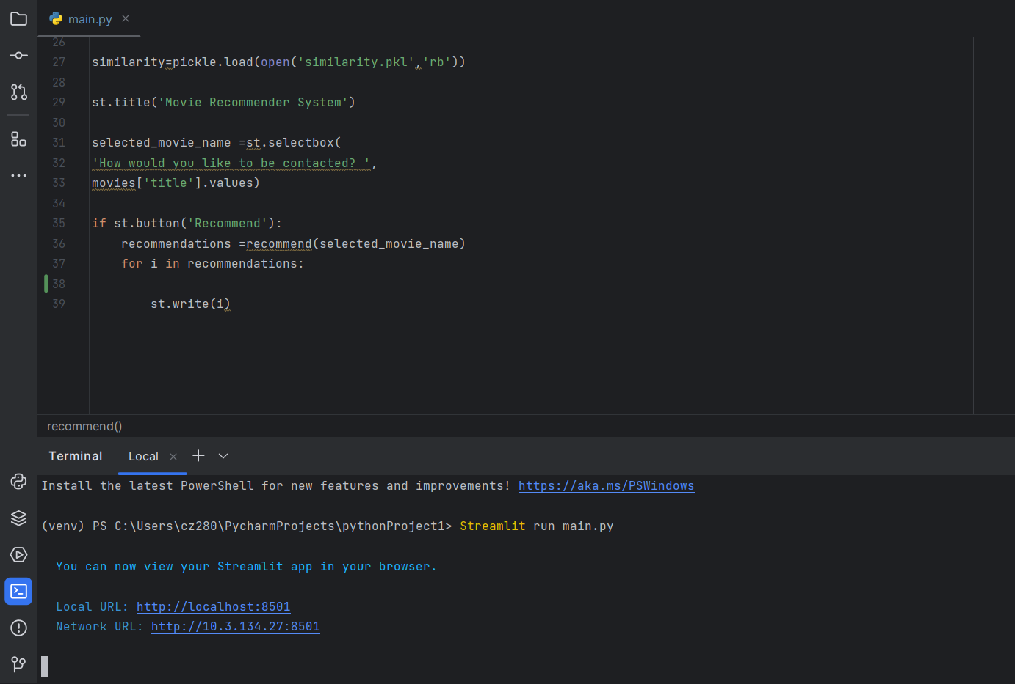

Slide 9

OUTPUT

Slide 10
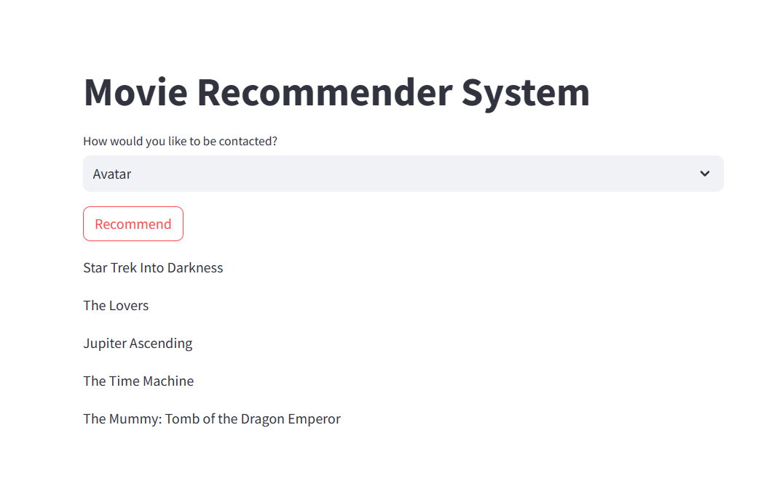

Slide 11
Literature Review
Sr.no | Title/Authors | Techniques Used | Limitations
1 | Content-Based Recommendation Systems byRobin Burke and Bamshad Mobasher(2007) | Content Representation Similarity Measures Profit Creation Filtering Algorithms Evaluation Method | Inability to capture diverse user interests.
2 | Content-Based Music Recommendation via User and Item Profiles by Paul Lamere (2002) | hybrid systems that combine content-based and collaborative filtering methods | As the number of items and users grows, the computational complexity can become a limiting factor.

Slide 12
INFERENCE FROM LITERATURE REVIEW
These systems analyze the content of items and match them with users' preferences.
They use user profiles or historical interactions to tailor recommendations to each user's specific interests.
Since they rely on item characteristics and historical user behavior, the recommendations tend to be similar to what users have already interacted with.
Without user data, these systems cannot generate personalized recommendations.
The system can leverage both item content and user behavior to generate better suggestions.

Slide 13
References
Y. Blanco-Fernández et al.An improvement for semantics-based recommender systems grounded on attaching temporal information to ontologies and user profilesEngineering Applications of Artificial Intelligence(2011)
J. Bobadilla et al.Collaborative filtering adapted to recommender systems of e-learningKnowledge-Based Systems(2009)
Jesus. Bobadilla et al.A framework for collaborative filtering recommender systemsExpert Systems with Applications(2011)
Jesús. Bobadilla et al.Collaborative filtering based on significancesInformation Sciences(2012)
Jesús. Bobadilla et al.A collaborative filtering similarity measure based on singularitiesInformation Processing and Management(2012)
I. Cantador et al.Categorising social tags to improve folksonomy-based recommendationsWeb Semantics: Science, Services and Agents on the World Wide Web(2011)

